Slide 1
Deploy VMware Skyline and Skyline Health Diagnostics via PowerCLI
CODE1554LV
(Part 1)
Russell Hamker
Principal VMware Engineer
#vmwareexplore #CODE1554LV
Broadcom Proprietary and Confidential. Copyright © 2024 Broadcom.
All Rights Reserved. The term “Broadcom” refers to Broadcom Inc. and/or its subsidiaries.

Slide 2

About me
Who is this guy?
About Me:
Russell Hamker
VMUG Leader – Wichita KS
16+ years Running VMware
VCP5-2023
VCAP 2022
Title – Principal VMware Engineer
vExpert – 9 years and running
Twitter - @butch7903
Tanzu Vanguard
https://linktr.ee/russellhamker

Slide 3
Agenda
VMware PowerCLI Hero’s
PowerShell Basics
VMware vApps
PowerCLI vApp Backups / restores
Demo
VMware Skyline Overview
The Code
Demo

Slide 4





VMware PowerCLI Hero’s
William Lam
Senior Staff Solution Architect
@lamw
Alan Renouf
Advanced Projects Lead at VMware
@alanrenouf
Cormac Hogan
Chief Technologist at VMware
@CormacJHogan
Luc Dekens
vExpert 2009-2022/ Co-author VMware vSphere PowerCLI @LucD22
Vladan Seget
Founder and Executive Editor of ESX Virtualization Blog
@vladan

Slide 5
The Basics
PowerShell is an object-oriented programming language invented by Jeffrey Snover at Microsoft.
It is a cross-platform (Windows, Linux, and macOS) automation and configuration tool/framework that works well with your existing tools and is optimized for dealing with structured data (e.g. JSON, CSV, XML, etc.), REST APIs, and object models. It includes a command-line shell, an associated scripting language and a framework for processing cmdlets.
VMware took great interest as vCenter used to run on Windows
PowerShell converts API calls to cmdlets (commandlets)
PowerShell modules are a set of cmdlets that allow you to do things

Slide 6
Types of Commands
Examples:
Get
Set
Remove
Restart
Import/Export
Clear

Slide 7
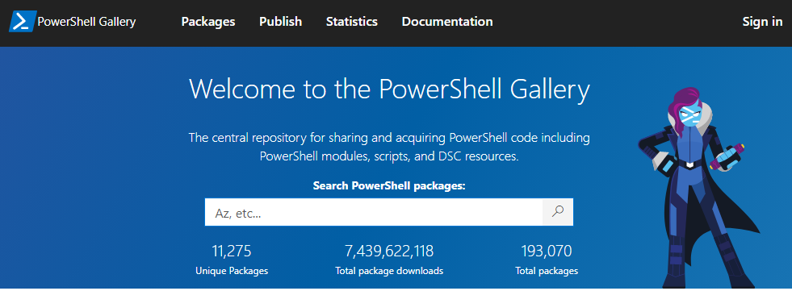
PowerShell Gallery
The Site to get most PowerShell Modules:
https://www.powershellgallery.com

Slide 8
File Types
Different File Types for PowerShell
Powershell Scripts (*.ps1)
Powershell Modules (*.psm1)
Powershell Data Files (*.psd1)
Powershell Session Configuration Files (*.pssc)
Powershell Role Capability Files (*.psrc)
Powershell Xml Files (*.psxml, *.cdxml)

Slide 9
Cmdlet Parameters
Aka Flags
Get-VMHost [[-Name] <String[]>] [-Datastore <StorageResource[]>] [-Location <VIContainer[]>] [-NoRecursion]
[-Server <VIServer[]>] [-State <VMHostState[]>] [-Tag <Tag[]>] [<CommonParameters>]
Get-VMHost [[-Name] <String[]>] [-Datastore <StorageResource[]>] [-Location <VIContainer[]>] [-NoRecursion]
[-ResourcePool <ResourcePool[]>] [-Server <VIServer[]>] [-Tag <Tag[]>] [-VM <VirtualMachine[]>]
[<CommonParameters>]

Slide 10
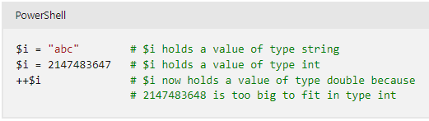
Variables - Info
A variable is a unit of memory in which values are stored.
In PowerShell, variables are represented by text strings that begin with a dollar sign ($), such as $a, $process, or $my_var.
A variable represents a storage location for a value, and that value has a type.

Slide 11
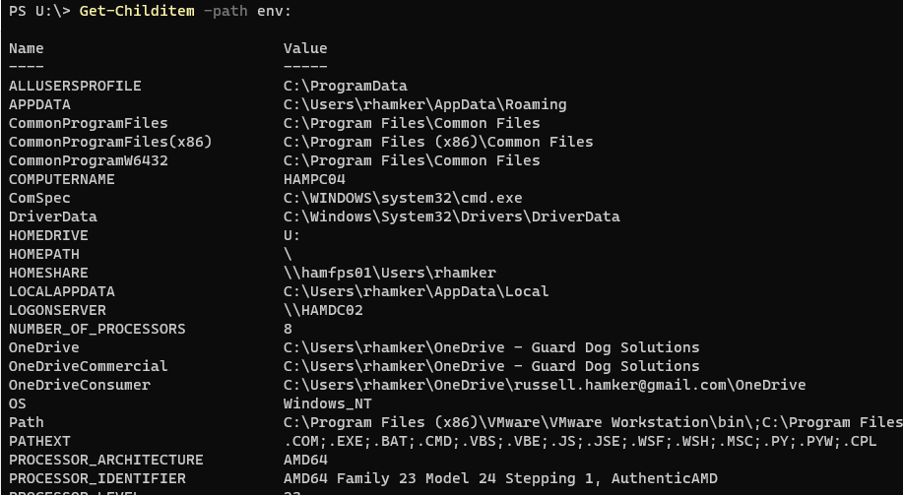
Environment Variables
Environment variables store data that's used by the operating system and other programs.
Get-Childitem –path env:

Slide 12
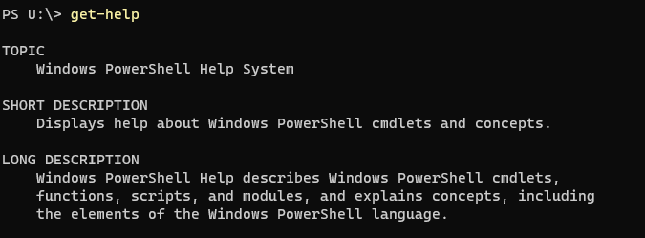
Get-Help
Displays information about PowerShell commands and concepts.

Slide 13
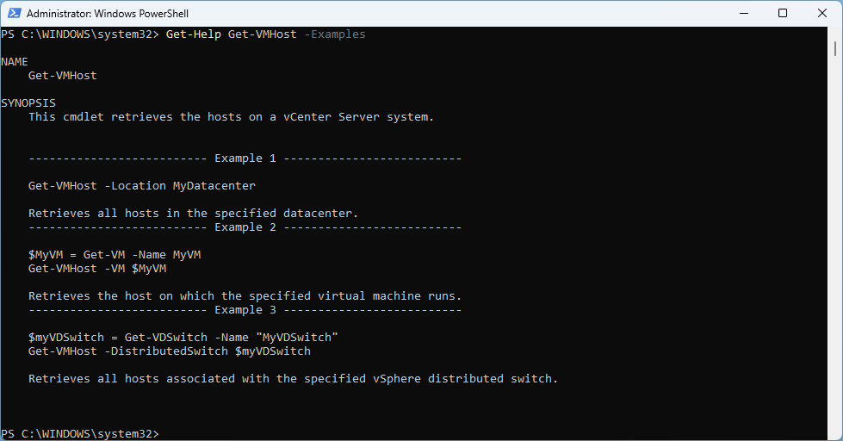
Get-Help with Examples
Most Get-Help areas for a PowerShell Cmdlet include examples of how to run the command.

Slide 14
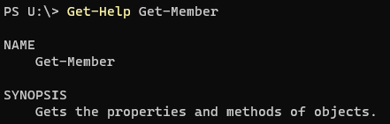
Get-Member
Gets the properties and methods of PowerShell objects

Slide 15
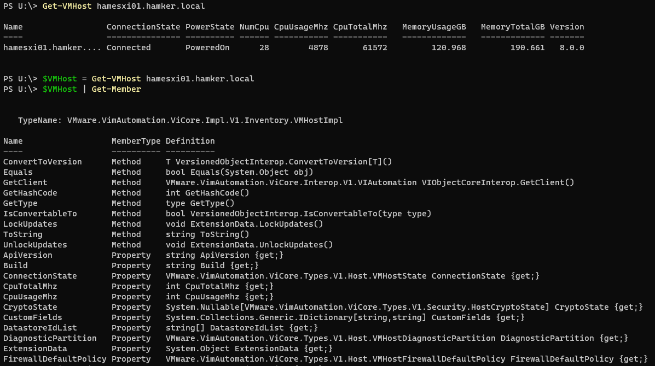
Get-Member Example
$VMHost | Get-Member

Slide 16
VMware VM vApp Options
You can enable and configure vApp functionality for virtual machines that are not within a vApp. When a virtual machine vApp options are enabled, you can configure OVF properties, use the OVF environment, and specify IP allocation and product information for the virtual machine.
You can configure and modify the authoring vApp options of a virtual machine to specify custom information that is preserved and used when you export the virtual machine as an OVF template. If you later deploy that OVF template, the information that you specified is available for editing in the deployment vApp options of the virtual machine.
For a virtual machine with vApp options enabled, the authoring vApp options are preserved when you export the virtual machine as an OVF template and those options are used when you deploy a new virtual machine from that template. Deployment vApp options are available for virtual machines that are deployed from OVF templates.
https://docs.vmware.com/en/VMware-vSphere/8.0/vsphere-vm-administration/GUID-A6F34BAC-BF8B-4513-AB8C-14891B439D2D.html

Slide 17
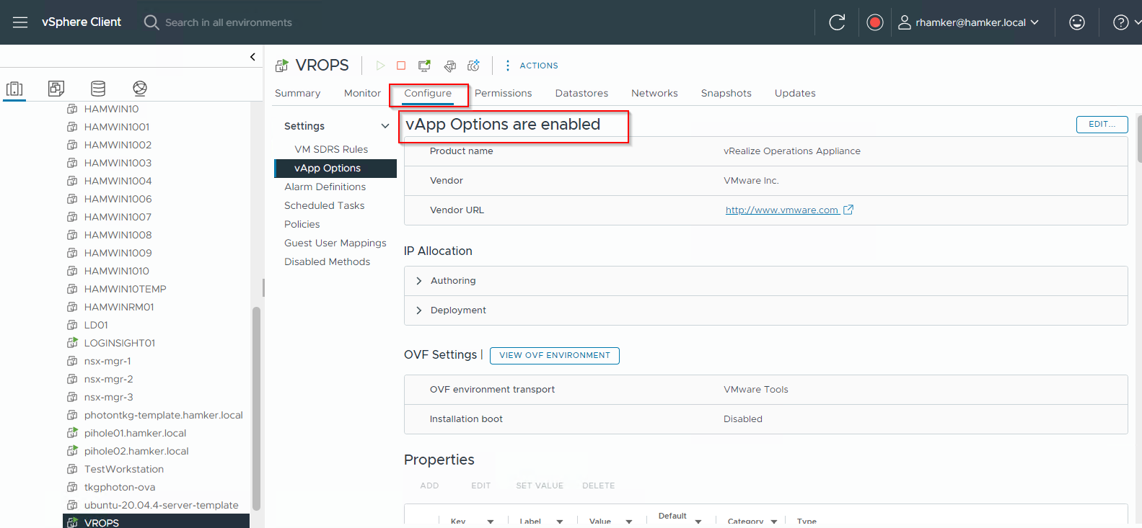
VMware VM vApp Options

Slide 18
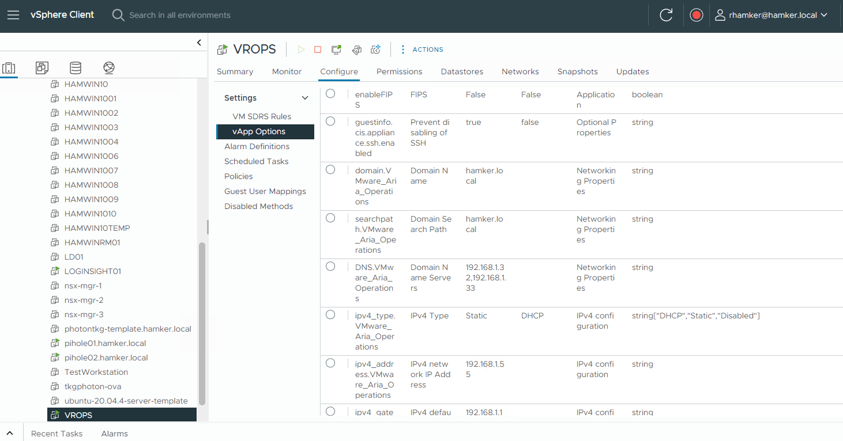
VMware VM vApp Options

Slide 19
What happens if I move a VM vApp to a different VCSA
VM vApp Options are ONLY stored in the VCSA DB. They are NOT appart of the VMX file.
If the VCSAs are linked, the vApp Options will stay intact when a VM is migrated to another VCSA
If the VCSAs are NOT connected, you will loose the vApp Options and configuration. This can be avoided by backing up the VM vApp configurations prior to VM migration.

Slide 20
Backup / Restore of VMware VM vApps
You can run PowerCLI to backup and restore VMware VM vApp configuration
Backup Code

Slide 21
Restore / Import VMware VM vApp Configuration
Use PowerCLI to restore VMware VM vApp Configuration

Slide 22
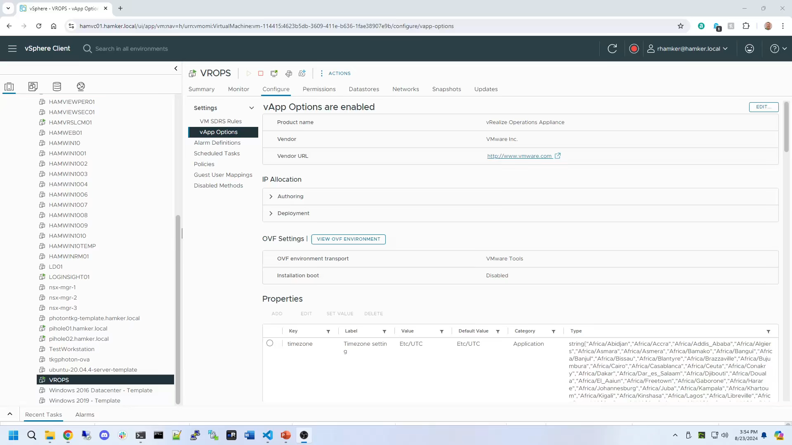

Slide 23
Skyline Diagnostics Overview Overview
VMware Skyline Health Diagnostics tool is a self-service diagnostics platform. This tool helps to detect issues in the vSphere and vSAN product line and provides recommendations in the form of a Knowledge Base article or remediation procedures to address the identified issues. vSphere administrators can use this tool to troubleshoot issues before contacting VMware Global Support Service.
VMware Skyline Health Diagnostics supports VMware vCenter plugin registration from its user interface. You can register with VMware vCenter Server on or above 7.0. After successful plugin registration, you can trigger the diagnostics on VMware vCenter Server, monitor the task status and view the analysis report from vSphere client interface itself.

Slide 24
Info/Site
https://docs.vmware.com/en/VMware-vSphere/8.0/vsphere-monitoring-performance/GUID-D9DDF7B6-1F44-4F0F-BFE7-0DBCAF2F8CA5.html
Or
https://docs.vmware.com/en/VMware-Skyline-Health-Diagnostics/index.html

Slide 25
The Code

Slide 26
Demo Time!

Slide 27


Slide 28
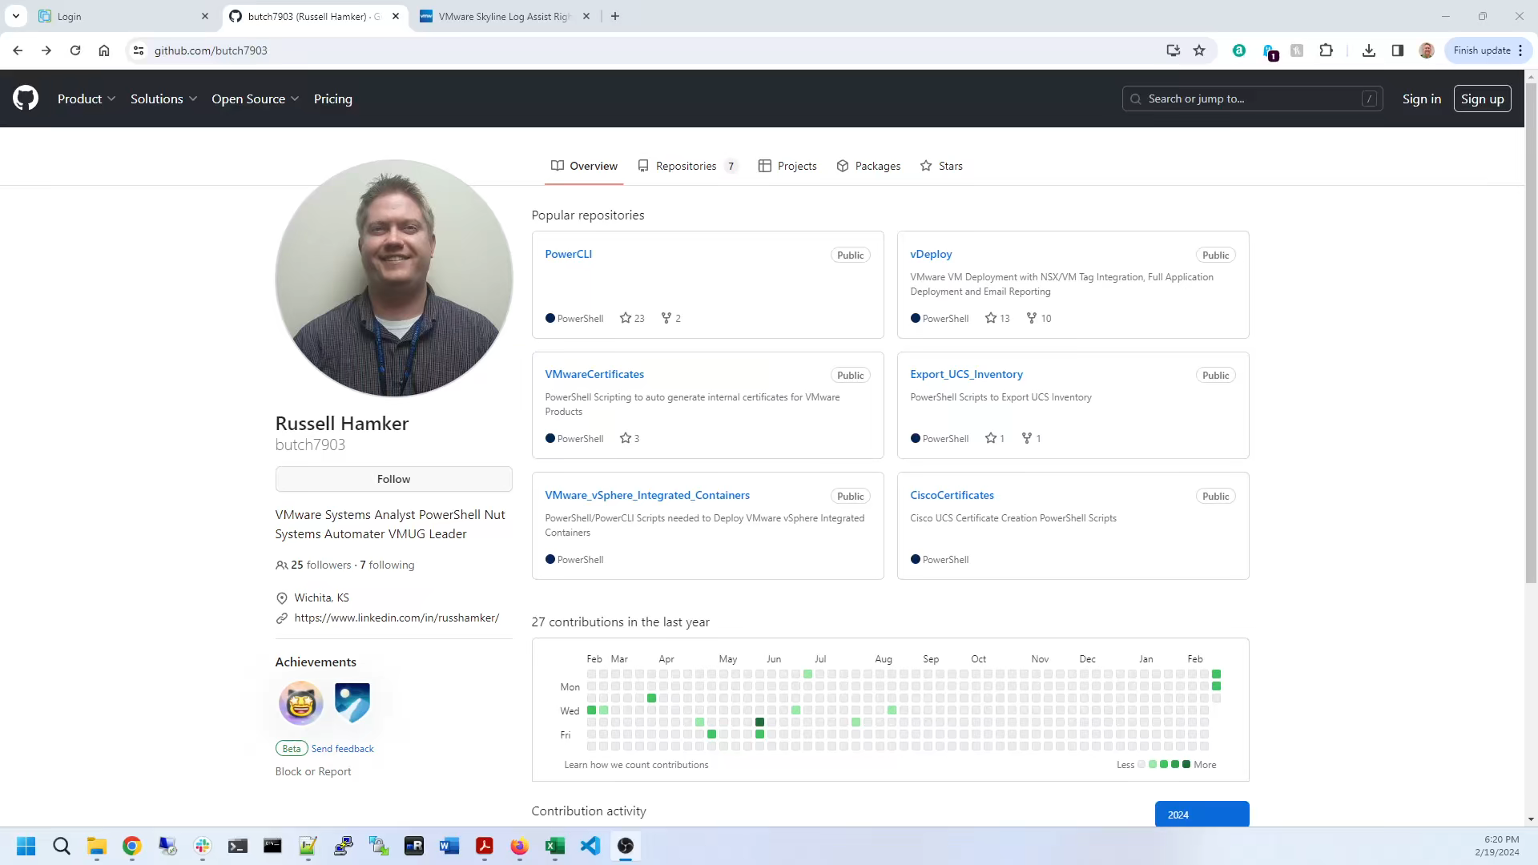

Slide 29




Stay Connected Let’s continue the conversation
Russell Hamker
Principal VMware Engineer
https://linktr.ee/russellhamker
https://github.com/butch7903 https://github.com/guarddog-dev
Twitter: @butch7903 https://twitter.com/butch7903
LinkedIn: https://www.linkedin.com/in/russhamker/
#vmwareexplore #CODE1554LV
Broadcom Proprietary and Confidential. Copyright © 2024 Broadcom.
All Rights Reserved. The term “Broadcom” refers to Broadcom Inc. and/or its subsidiaries.

Slide 30
Please take your survey.
Broadcom Proprietary and Confidential. Copyright © 2024 Broadcom.
All Rights Reserved. The term “Broadcom” refers to Broadcom Inc. and/or its subsidiaries.

Slide 31
Thank You
Broadcom Proprietary and Confidential. Copyright © 2024 Broadcom.
All Rights Reserved. The term “Broadcom” refers to Broadcom Inc. and/or its subsidiaries.

Slide 32
HEVC Codec for Presentation
Demo playback requires HEVC Codecs
To install:
Windows:
Via PowerShell: start ms-windows-store://pdp/?ProductId=9n4wgh0z6vhq
Install free codec pack for HEVC
MAC:
https://download.divx.com/stable/divx/DivXInstaller.dmg
Install dmg file

